Slide 1
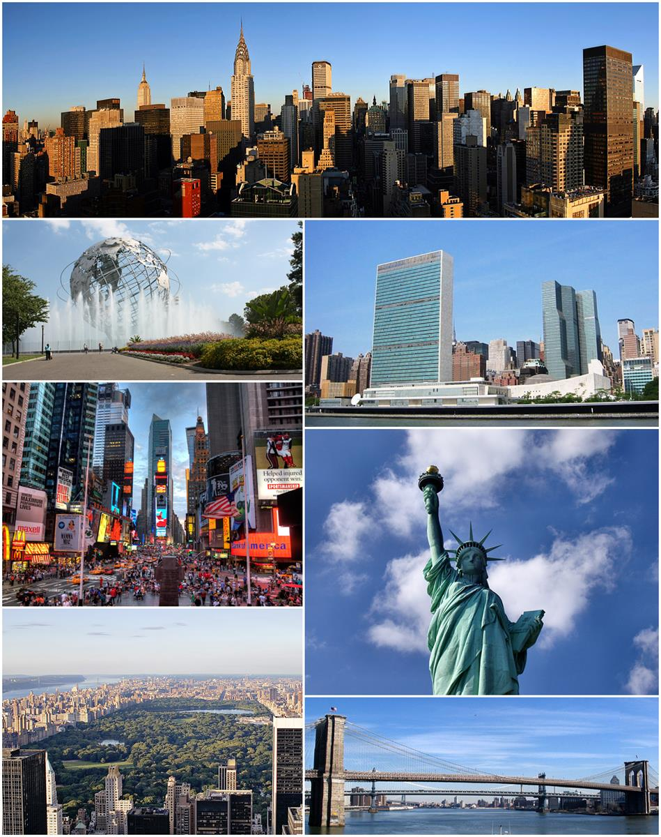
Hot Dining in New York City
Mapping and discovering the availability of New York City’s Michelin Star-rated restaurants

Slide 2
Contents
Data Used
Motivation
What We Wanted to Make
Conclusions
Potential Improvements

Slide 3
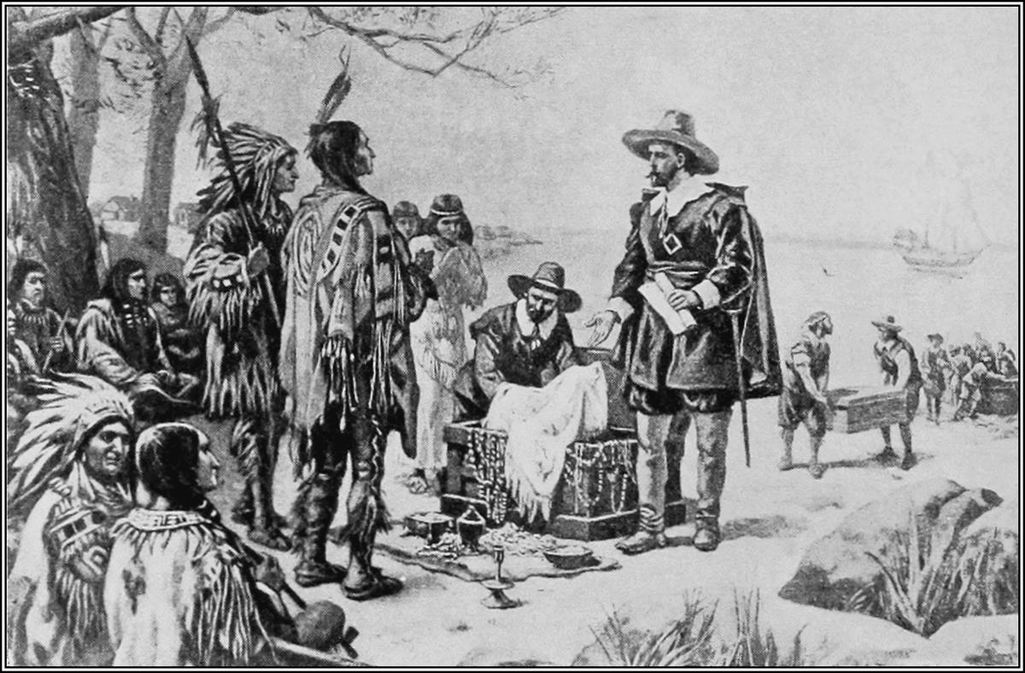
Data Used
We used a Michelin Star restaurant csv file we downloaded from Kaggle.com
We used the URL’s and API keys of reservation platforms like Resy and OpenTable
We also used the Google Geocoding API to find the exact coordinates of each restaurant
Notes:
Consider talking about:
Etymology
Early history
Dutch rule
English rule
American Revolution
Nineteenth century
Modern history

Slide 4
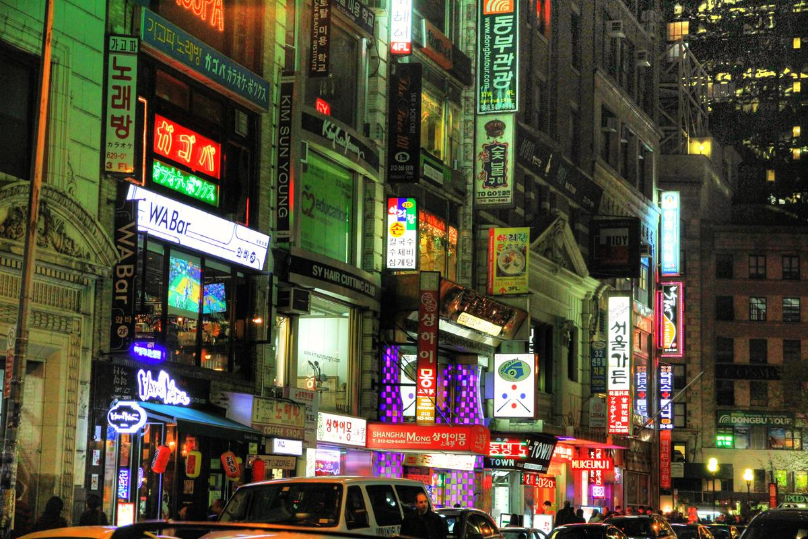
Motivation
We wanted to create an interactive map of New York City’s highest-rated restaurants
We not only wanted to create a map/visualization of the restaurants but also tried to show the availability of any Michelin Star-rated restaurants
Notes:
Consider talking about:
Population density
Race and ethnicity
Sexual orientation and gender identity
Religion
Wealth and income disparity

Slide 5

What We Wanted to Make
An app that provides the end user the ability not just to locate New York’s most critically-acclaimed restaurants but also book reservations to those restaurants
Notes:
Consider talking about:
City economic overview
Wall Street
Tech and biotech
Real estate
Tourism
Media and entertainment

Slide 6
Conclusions
Many Michelin Star-rated restaurants have last minute availability
These restaurants are concentrated in Manhattan and Brooklyn, mostly
Notes:
Consider talking about:
Primary and secondary education
Higher education and research

Slide 7
Potential Improvements
We would ideally be able to provide this kind of “last minute restaurant availability” benefit to more restaurants…think of Hotel Tonight but for restaurants
We would also like to be able to scale this to other cities in other countries
Notes:
Consider talking about:
Public health
Public safety
Public library system

